Slide 1

DSA
Module Briefing
Data Structures and Algorithms (DSA)
Diploma in CSF, IT
Year 2/3 (2020/21), Semester 4/6
Notes:
Dip CSF – core
Dip IT, FI – optional elective

Slide 2
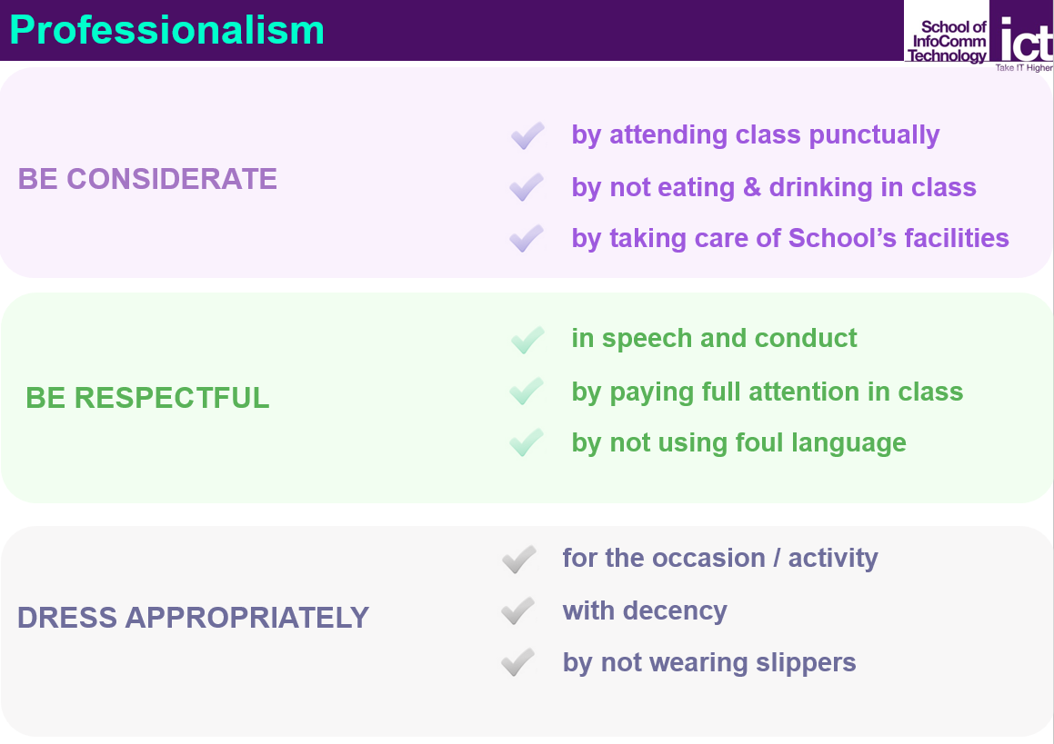
Professionalism@ICT

Slide 3
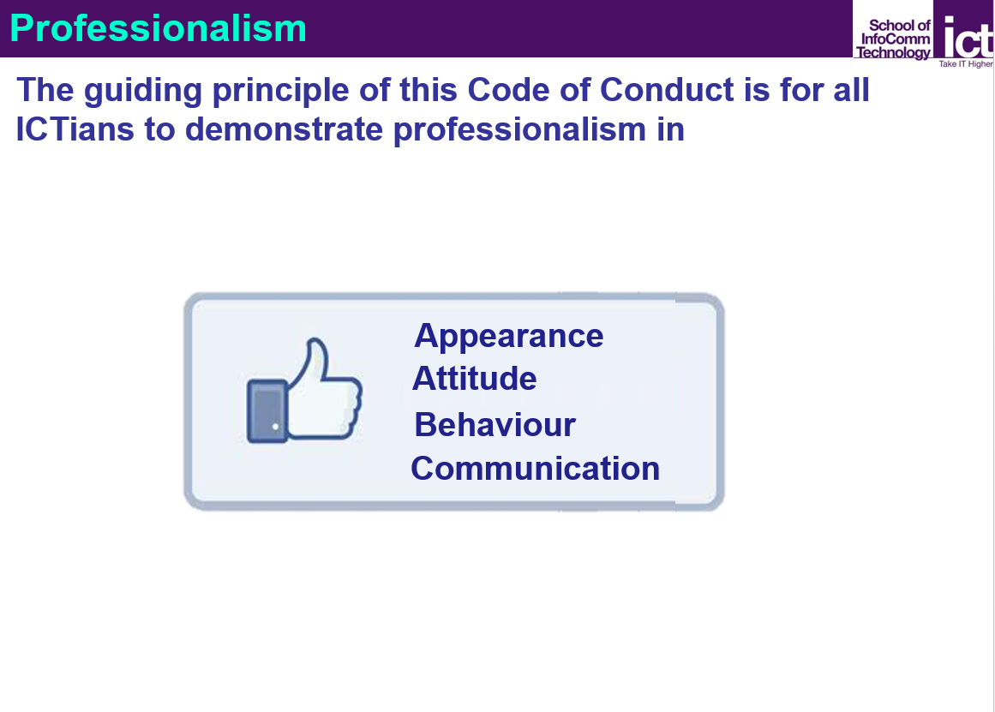
Professionalism@ICT

Slide 4

Teaching Team
Ms LEE Ching Yun
Email: lcy9@np.edu.sg
Work Phone: 6460 8228
Mr LIM Poh Seng
Email: lps@np.edu.sg
Work Phone: 6460 6886
Dr Pamela LOY
Email: lsm@np.edu.sg
Work Phone: 6460 6722
Mr TEO Wen Qiang
Email: twq2@np.edu.sg
Work Phone: 6460 7237

Slide 5
What you will be learning …
Upon successful completion of this module, you should be able to
Select and construct appropriate data structures to represent the data inherent in the problem domain
Analyse and construct suitable algorithms based on the data structures
Teaching Plan
Refer to MeL → DSA → Module Information

Slide 6
Teaching Plan
19 Oct 2020 – 14 Feb 2021
Week 1 to 9
TWO weeks break (Dec - Jan)
Week 12 to 17
Assignment (weeks 14 - 16)
Holidays
14 Nov 2020 Deepavali holiday
12 – 13 Feb 2021 CNY holiday

Slide 7
Assessment
Assessment Type | Weightage
CA (Continuous Assessment) | 20%
Test 1 | 20%
Test 2 | 20%
Assignment | 40%
Total | 100%

Slide 8

CA – Continuous Assessment (20%)
Participation in tutorials and practicals (weekly)
“learn from expert” - video segments
“VisuAlgo” – online tool to visualise data structures and algorithms through animation
Work done during practical sessions to be submitted to the DSA network folder

Slide 9

Test 1 (20%)
Conducted in week 9
Testing on understanding and application of concepts from weeks 1-7
1 hour duration
Open-book
Online Submission

Slide 10
Test 2 (20%)
Conducted in week 17
Testing on understanding and application of concepts from weeks 8, 9, 12, 13
1 hour duration
Open-book
Online Submission

Slide 11

Assignment (40%)
To develop an application (team with individual component) according to given problem specification
Weeks 14 to 16
Warning: Additional hours beyond class are expected. You have to start early.

Slide 12
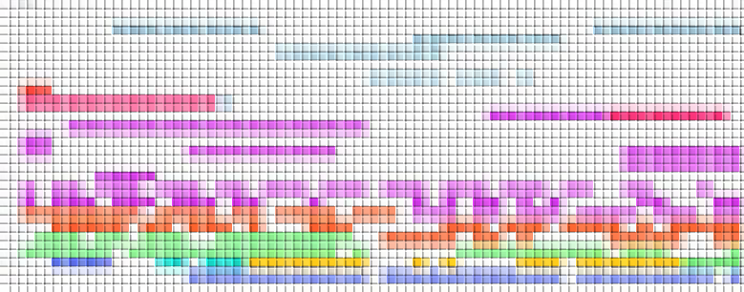
Weekly Schedule
Mon
Tues
Sessions | Activities
Session 1 | Lecture Tutorial
Session 2 | Practical Exploration
Wed
Session 1 refers to the first and second lesson of the week respectively.
Do check your timetable on whether you need to go to classroom or hbl.

Slide 13
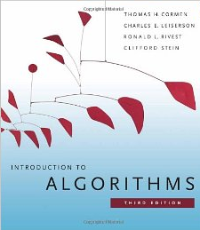
References
Data Structures and Problem Solving with C++ (6th Edition), Frank M. Carrano, Prentice Hall
Introduction to Algorithms (3rd Edition), Thomas H. Cormen, Charles E. Leiserson, Ronald L. Rivest, Clifford Stein, The MIT Press
Useful Online References
http://ocw.mit.edu/courses/electrical-engineering-and-computer-science/6-046j-introduction-to-algorithms-sma-5503-fall-2005/video-lectures/
Please share your online resources with your tutor or classmates.

Slide 14

Resources
Recommended
Visual Studio Professional 2019
Others
Visual Studio Code
Dev C++
Eclipse
Code::Blocks

Slide 15
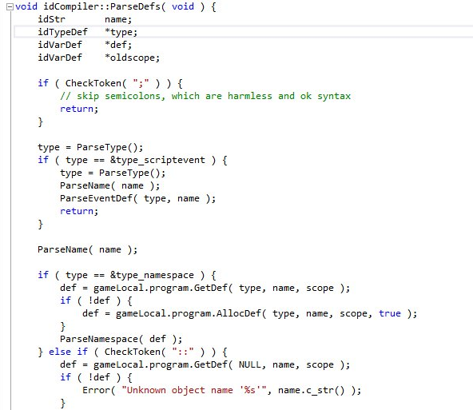
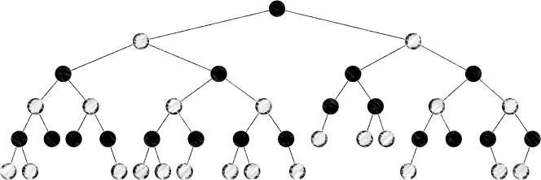

The Journey Begins…
Enjoy!!

